Slide 1
Creating Dashboards with Python
More specifically – plotly & Dash
Fall 2021
We are going to be using kaggle.com to run our python code.
If you do not already have a kaggle account, please take a few minutes now to create one. Select ‘Register’
You can use your CDC email
There are no cost associated with the account.
I will be giving you code that we will upload to kaggle.

Slide 2
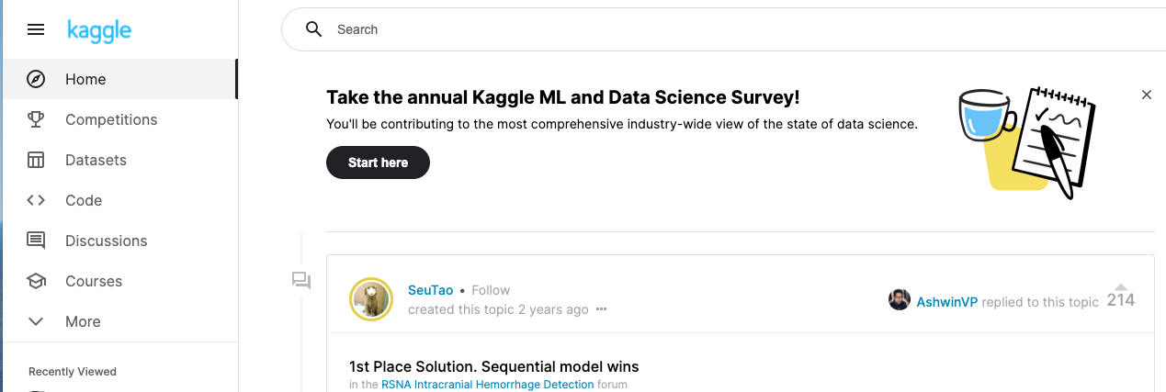
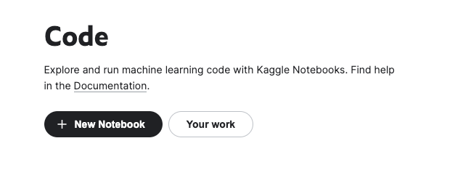
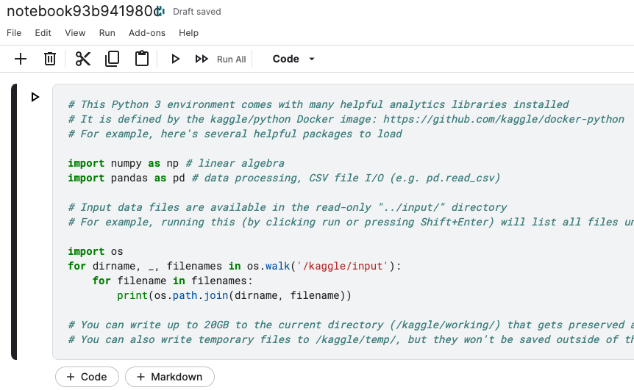
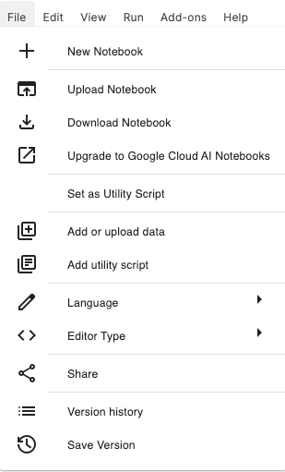
Upload a notebook
From the Home page select Code.
Select New Notebook.
It will take a few seconds for the new notebook to prepare. Wait for the green text box.
From the menu bar select File > Upload Notebook.

Slide 3
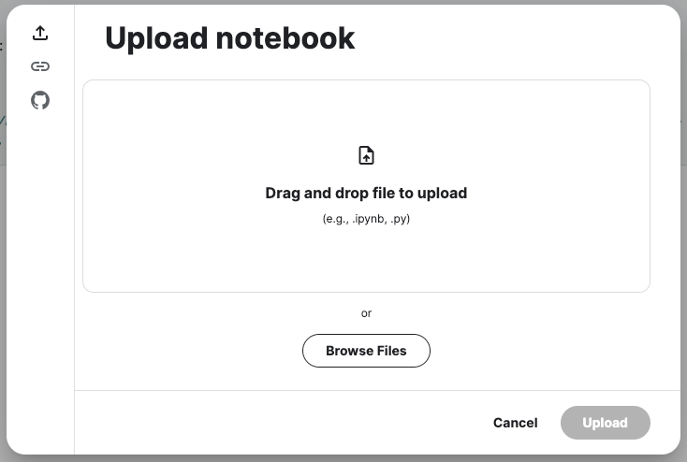
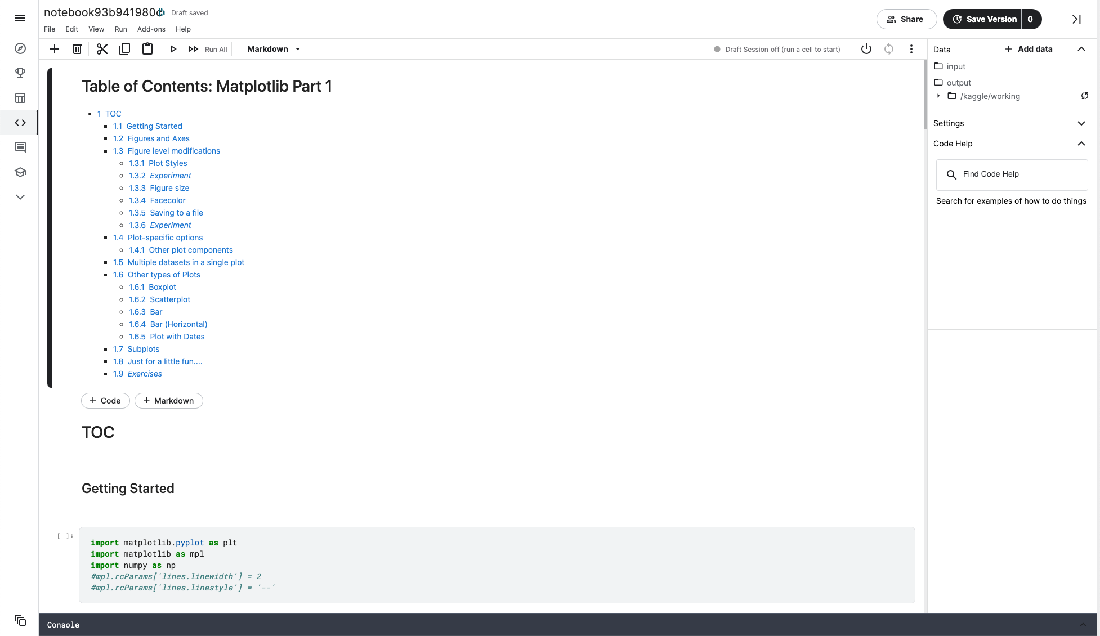
Upload a notebook
Browse files to select the appropriate notebook.
Press Upload.
Double-click the notebook name to change it.

Slide 4
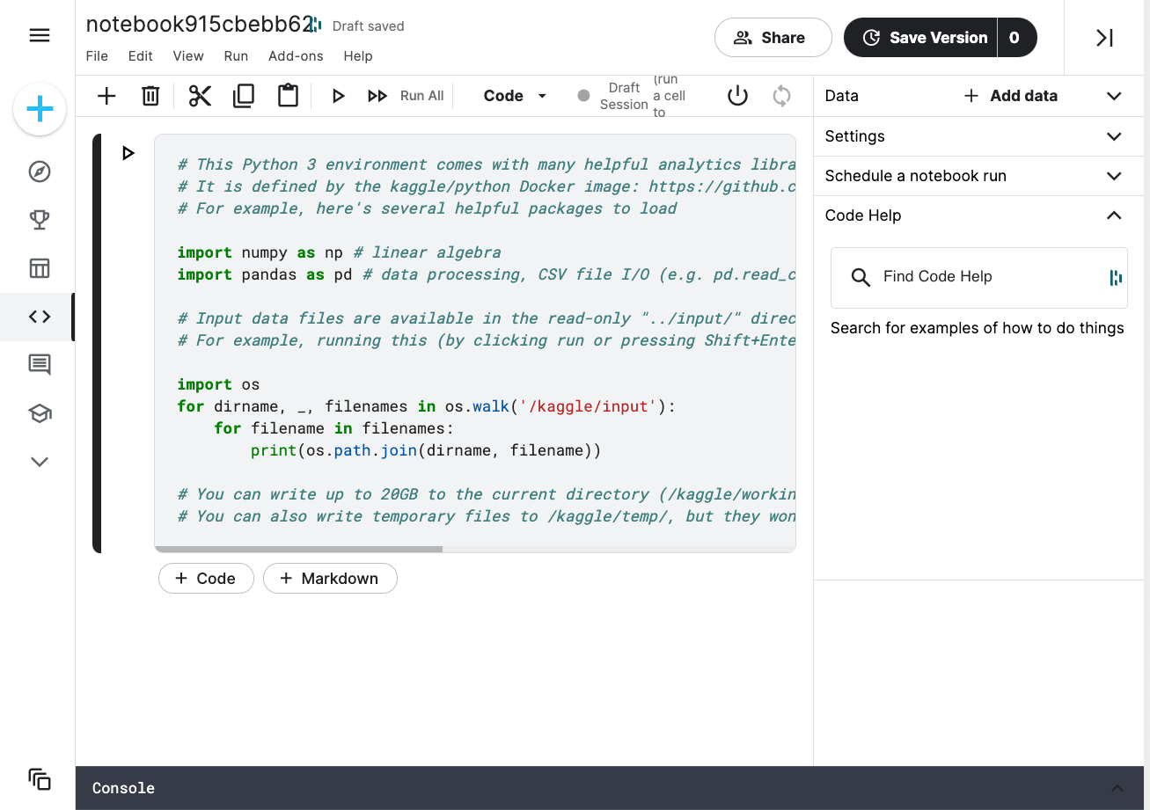
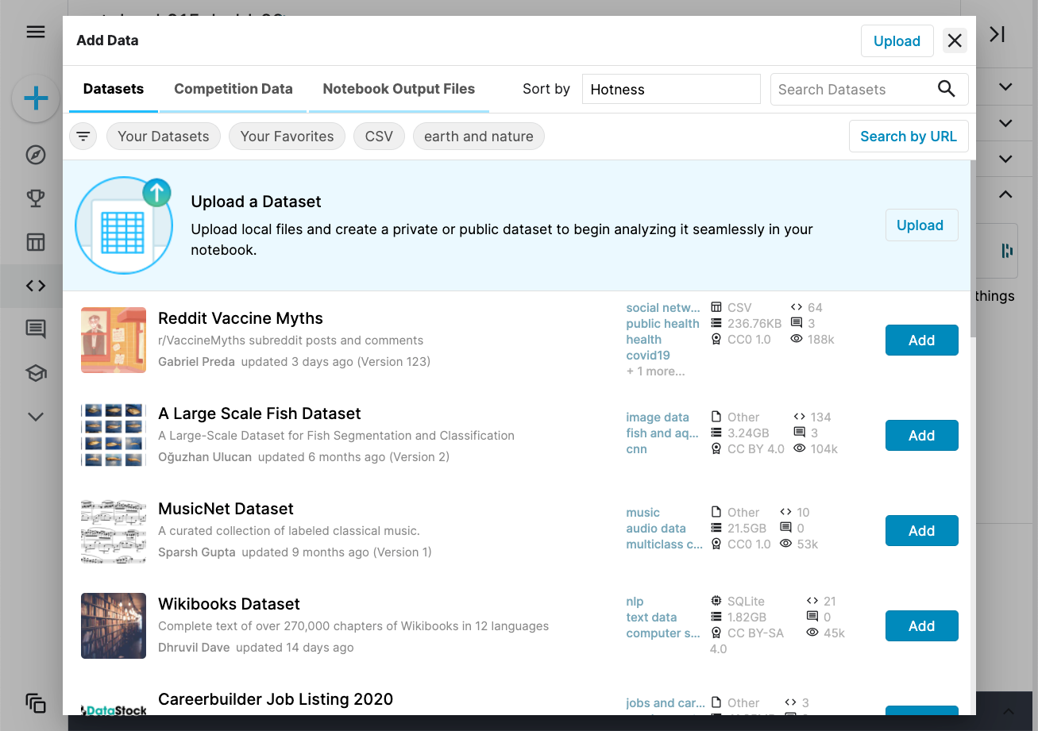
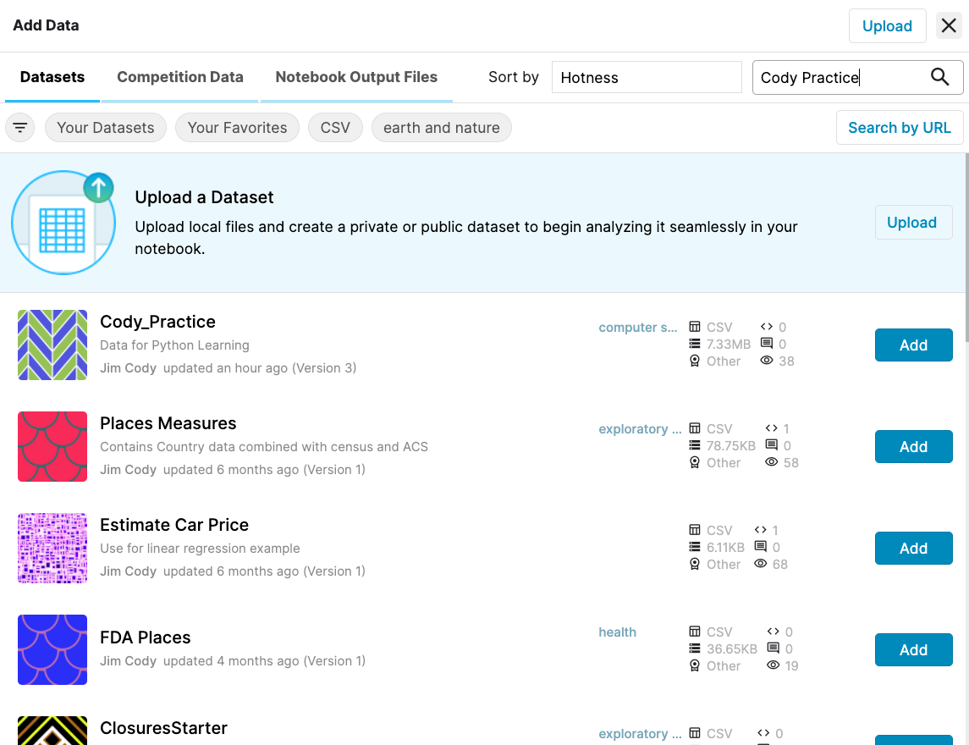
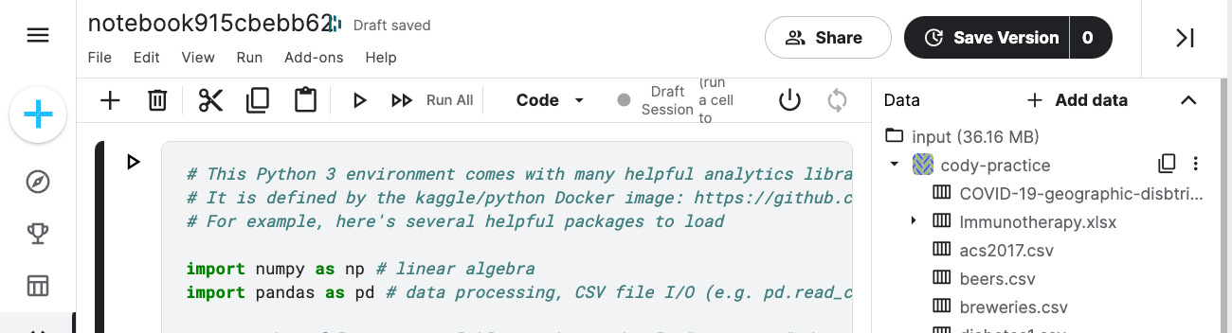
Add a Dataset to a Kaggle notebook
Press the Add data text in the top right corner of the notebook. A new window will appear.
In Search Datasets text box, enter Cody Practice.
When the list of datasets appears, press the Add button next to Cody_Practice.
The dataset – and all of its associated files - will be associated with the notebook.

Slide 5
Housekeeping
In case of technical problems:
Something wrong on my end (e.g. power outage), I will send you an email.
Something wrong on your end, please send me a text message. 508-769-6446
jcodygroup@gmail.com
We have 4 hours for each session
I will try to give you an opportunity to stand and stretch every hour.
We will take at least one 15-minute break near the halfway point.

Slide 6
About me
Experience:
25+ years consulting and training experience
Extensive work with “big data” and analytics
15 years working with various data visualization tools
Education
Ed. M., Technology, Innovation & Education, Harvard University
PhD Candidate, Education Policy, University of Massachusetts, Amherst

Slide 7
Why kaggle.com
Ensure that we are all working with a consistent platform.
Uses jupyter notebooks for code writing and execution.
Many of datasets to choose from… including several shared by CDC.

Slide 8
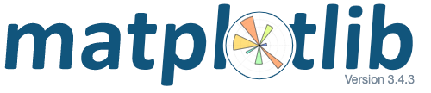
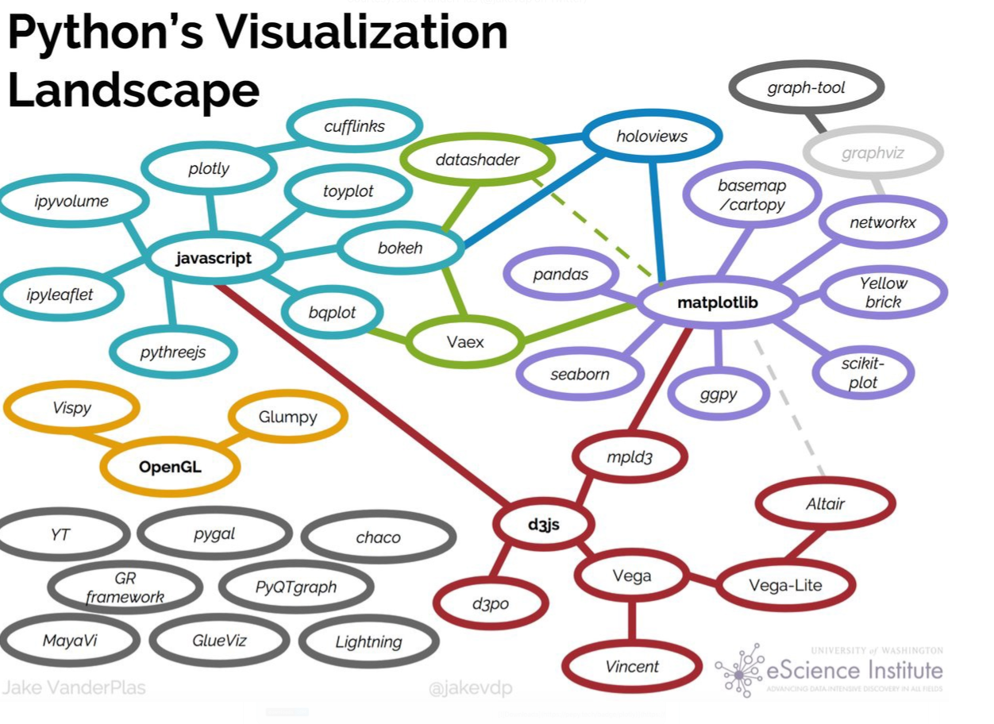




Slide 9
Visualization packages
Matplotlib
pyplot
seaborn
Plotly
express
Dashboard Options
Dash
Voila
Streamlit
Bokeh
Panel
quick &
easy
Matplotlib
Object-oriented
ggplot
Plotly
graph objects
Complex
& many
options
Altair
Built for interactivity

Slide 10
Our tasks
Plotly
Dash
Deploy to Web
Python
(notebooks
ipywidgets)
git
heroku
and through
kaggle

Slide 11
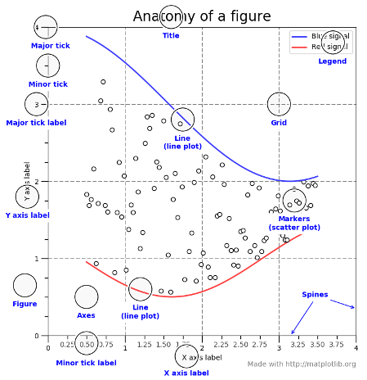
Matplotlib/Seaborn: Two big concepts to keep in mind
Figure
Axes
Plot
Figure
Axes
Plot 1
Plot 2
Figure
Axes
Axes
Plot 1
Plot
Plot 2

Slide 12
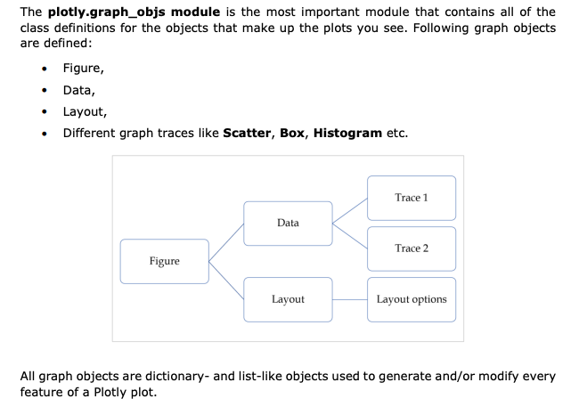
plotly graph objects

Slide 13
Day 2 - Dash
Plotly
Dash
Deploy to Web
Python
(notebooks
ipywidgets)
git
heroku
and through
kaggle
Today
plotly go
scatterplots
line plots
Build a dashboard
Review deployment

